Slide 1
Quality Of Service

Slide 2
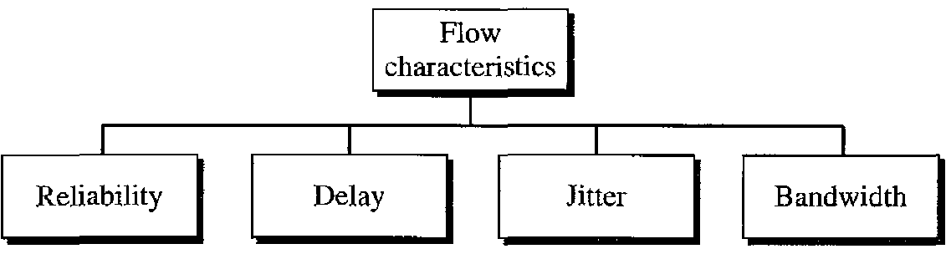
Flow Characteristics

Slide 3
Flow Characteristics
Reliability
Lack of reliability means losing a packet or acknowledgment, which entails retransmission.
Reliability is more important in email than in audio conferencing.
Delay
Source-to-destination delay
- Applications can tolerate delay in different degrees.

Slide 4
Flow Characteristics
Telephony, audio conferencing, video conferencing, and remote log-in need minimum delay.
Delay in file transfer or e-mail is less important.
Jitter
Jitter is the variation in delay for packets belonging to the same flow.
Example 1: packets 0,1,2,3 arrive at 20, 21,22,23
time of arrival 20.

Slide 5
Flow Characteristics
Example 2: 0,1,2,3 arrive at 20,22,21,23.
Applications : audio and video uniform delay is important between the packets.
High jitter means the difference between delays is large; low jitter means the variation is small.
Bandwidth
Different applications need different bandwidths.
- Video conferencing we need to send millions of bits per second to refresh a color screen.

Slide 6
TECHNIQUES TO IMPROVE QoS
Scheduling
Packets from different flows arrive at a switch or router for processing.
A good scheduling technique treats the different flows in a fair and appropriate manner.
FIFO queuing
Priority queuing
Weighted fair queuing

Slide 7
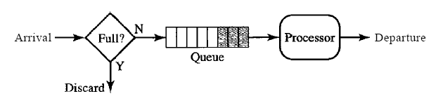
TECHNIQUES TO IMPROVE QoS
FIFO queuing
Node(Router or S/W)
Example: wait for a bus at bus stop

Slide 8
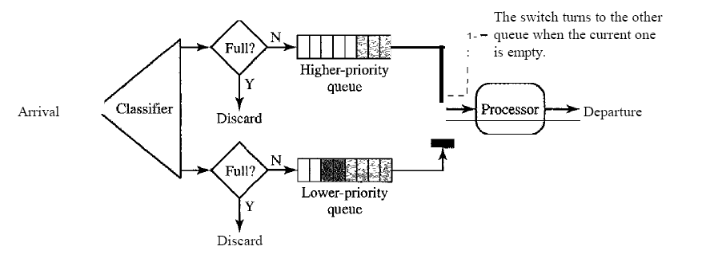
TECHNIQUES TO IMPROVE QoS
Priority queuing

Slide 9
TECHNIQUES TO IMPROVE QoS
A priority queue can provide better QoS than the FIFO queue because higher priority traffic, such as multimedia, can reach the destination with less delay.
Drawback of Priority Queuing
Starvation: of low priority queuing packets

Slide 10
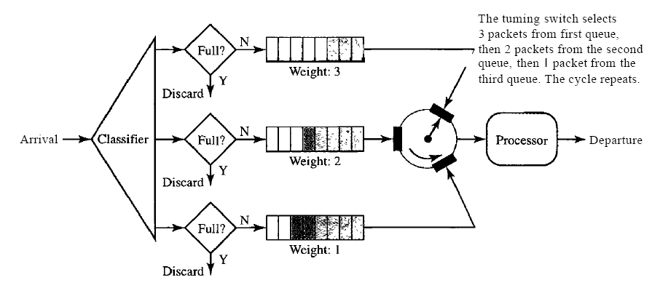
TECHNIQUES TO IMPROVE QoS
Weighted fair queuing
-

Slide 11
TECHNIQUES TO IMPROVE QoS
A better scheduling method is weighted fair queuing.
The packets are still assigned to different classes and admitted to different queues.
If the system does not impose priority on the classes, all weights can be equal.

Slide 12
TECHNIQUES TO IMPROVE QoS
Traffic Shaping
Traffic shaping is a mechanism to control the amount and the rate of the traffic sent to the network.
Leaky bucket
Token bucket.

Slide 13
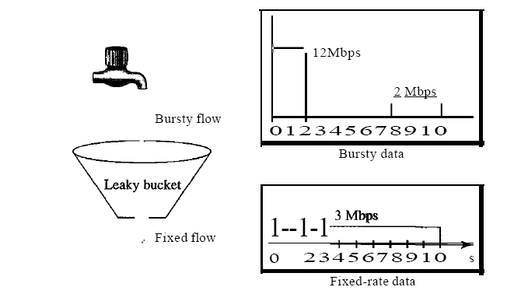
TECHNIQUES TO IMPROVE QoS
Leaky bucket

Slide 14
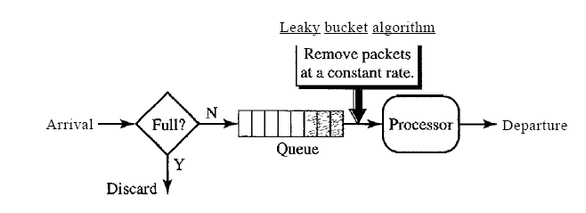
TECHNIQUES TO IMPROVE QoS
Leaky bucket implementation
A leaky bucket algorithm shapes bursty traffic into fixed-rate traffic by averaging the data rate. It may drop the packets if the bucket is full.

Slide 15
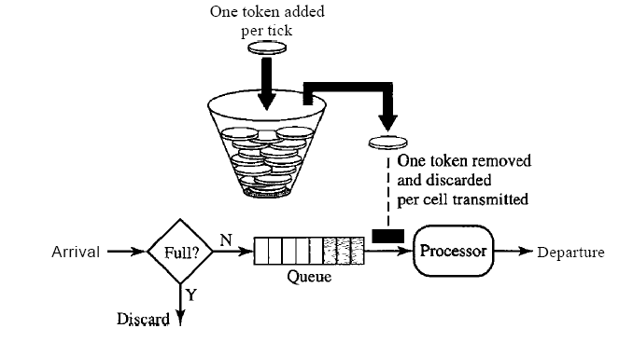
TECHNIQUES TO IMPROVE QoS
Token bucket
A token is added at every t time.

Slide 16
TECHNIQUES TO IMPROVE QoS
The token bucket algorithm as compared to leaky bucket allows output rate vary depending on size of burst.
The token bucket allows bursty traffic at a regulated maximum rate.

Slide 17
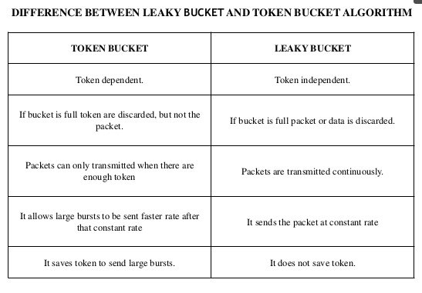

Slide 18
TECHNIQUES TO IMPROVE QoS
Resource Reservation
A flow of data needs resources such as a buffer, bandwidth, CPU time, and so on.
The quality of service is improved if these resources are reserved beforehand.

Slide 19
TECHNIQUES TO IMPROVE QoS
Admission Control
Admission control refers to the mechanism used by a router, or a switch, to accept or reject a flow based on predefined parameters called flow specifications.

